Slide 1
E-MAIL SPAM CLASSIFIER PROJECT
SUBMITTED BY,
Saranya M

Slide 2
INTRODUCTION
The project titled “Email Spam classification” is implemented using the CRISP-DM methodology. You will get to know Business understanding, Data Understanding (Data Description and Exploration)
Data Preparation, Modelling, and Evaluation steps. Project is implemented using Python class object-based style. Email spam detection is done using machine learning algorithms Naive Bayes and SVM (Support vector machines).
Further, it shows the complete program flow for Python-based email spam classifier implementation such as Data Retrieval Flow, Data Visualization Flow, Data Preparation Flow, Modeling, and Evaluation Flow.
Also, including the section regarding Data ethics. In case you want to understand and demystify the python code using a top-down approach visit the following link email spam classification and detection python code.

Slide 3
Business Understanding
Most of us consider spam emails as one which is annoying and repetitively used for purpose of advertisement and brand promotion. We keep on blocking such email-ids but it is of no use as spam emails are still prevalent. Some major categories of spam emails that are causing great risk to security, such as fraudulent e-mails, identify theft, hacking, viruses, and malware.
In order to deal with spam emails, we need to build a robust real-time email spam classifier that can efficiently and correctly flag the incoming mail spam, if it is a spam message or looks like a spam message. The latter will further help to build an Anti-Spam Filter.
Google and other email services are providing utility for flagging email spam but are still in the infancy stage and need regular feedback from the end-user. Also, popular email services such as Gmail, Yandex, yahoo mail, etc provide basic services as free to the end-user and that of course comes with EULA.
There is a great scope in building email spam classifiers, as the private companies run their own email servers and want them to be more secure because of the confidential data, in such cases email spam classifier solutions can be provided to such companies.

Slide 4
MULTI-LABEL VS MULTI CLASS CLASSIFICATION
For classifying a given message, first we preprocess it. For each word w in the processed messaged we find a product of P(w|spam).
If w does not exist in the train dataset we take TF(w) as 0 and find P(w|spam) using above formula.
We multiply this product with P(spam) The resultant product is the P(spam|message). Similarly, we find P(ham|message).
Whichever probability among these two is greater, the corresponding tag (spam or ham) is assigned to the input message.
Note than we are not dividing by P(w) as given in the formula. This is because both the numbers will be divided by that and it would not affect the comparison between the two.

Slide 5
Understanding Spam Emails
Let’s suppose you got up in the morning and opened your Gmail and found a mail saying something like:
“Hey, you have won an iPhone 10 in the luck draw conducted by amazon yesterday. To receive the prize please log in to your account and claim your gift.”
Seeing mail you first checked the sender and you found him to be genuine, and you happily rushed to the site and logged in and found there was no prize at all. Feeling sad you returned to your works.
A few hours later you received a message stating there has been a recent transaction from your bank account and you are shocked how it happened.
After telling the incident to the bank, they told you have been spammed and millions are facing the same difficulty, sounds terrible right!

Slide 6
Continued…
Spam emails are unwanted emails share in bulk intending to gather data/ do phishing/ perform social engineering/ start an attack and a lot more – mostly for bad causes. Usually, these are in form of advertisement and marketing stuff.
Since these are sent in bulk, each one will have a similar underlying pattern and format, so what the mechanism of google does is finds these underlying patterns and separates them.
This method is generally called spam classification and uses a model which is trained on spam and not a spam set of data.

Slide 7


Statement
We have a message m = (w1, w2, . . . . , wn), where (w1, w2, . . . . , wn) is a set of unique words contained in the message. We need to find
If we assume that occurrence of a word are independent of all other words, we can simplify the above expression to
In order to classify we have to determine which is greater

Slide 8
Data understanding
The email spam classifier focuses on either header, subject, and content of the email. In this project, we are focusing mainly on the subject and content of the email.
To download the email spam classification dataset files and complete code and visit the link email spam detection and classification project GitHub repository.

Slide 9
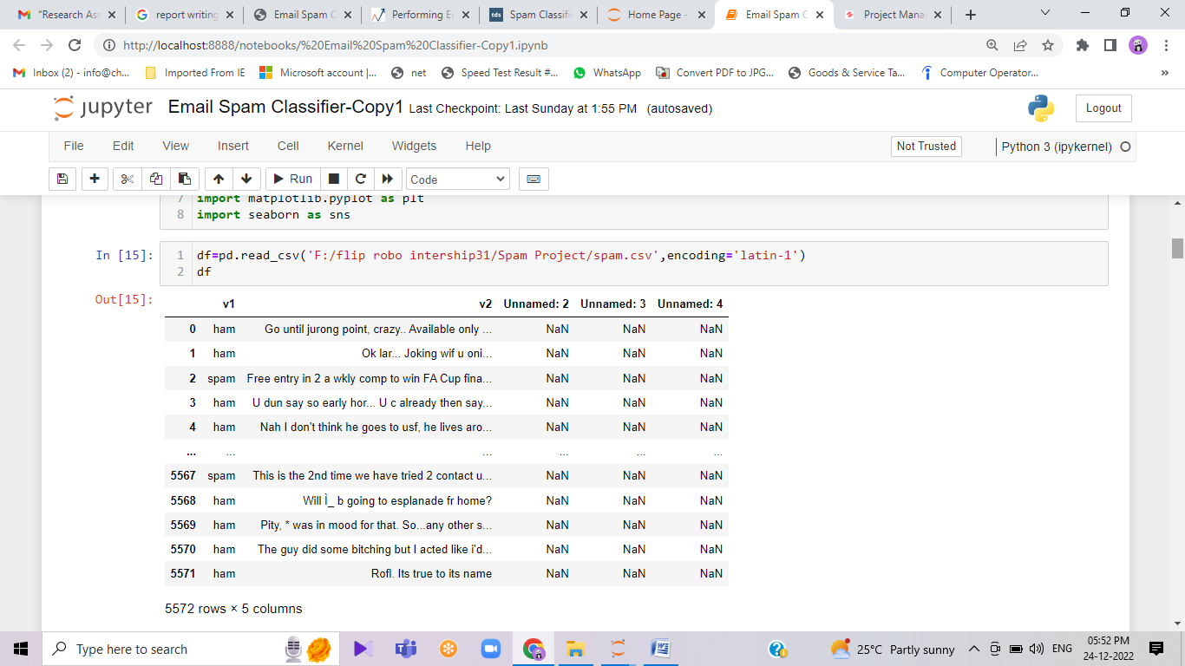
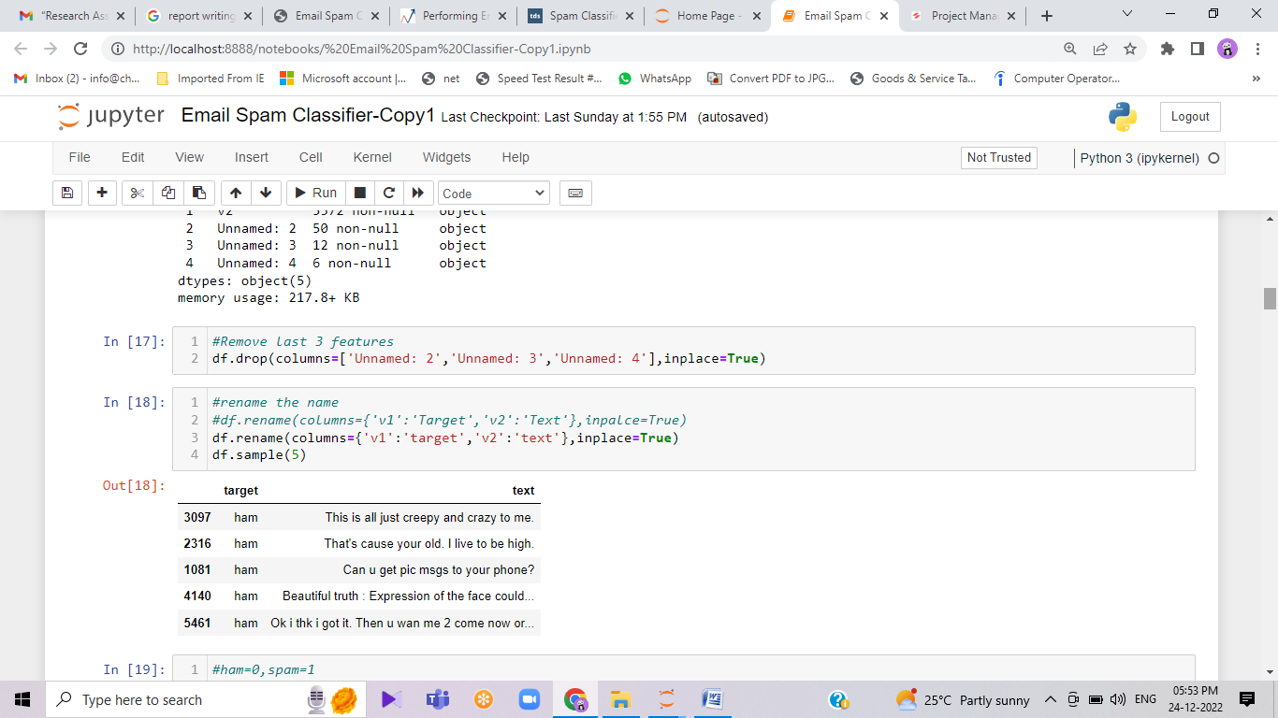
Data Description
The dataset contains two columns. The total corpus of 5728 documents. The descriptive feature consists of text. The target feature consists of two classes ham and spam, the column name is spam. The classes are labeled for each document in the data set and represent our target feature with a binary string-type alphabet of {ham; spam}. Classes are further mapped to integer 0 (ham) and 1 (spam).

Slide 10
ANALYTICAL PROBLEM FRAMING
Model Building Phase
You need to build a machine learning model. Before model building do all data pre-processing steps involving NLP. Try different models with different hyper parameters and select the best model. Follow the complete life cycle of data science. Include all the steps like-
Data Cleaning
Exploratory Data Analysis
Data Pre-processing
Model Building
Model Evaluation
Selecting the best model

Slide 11
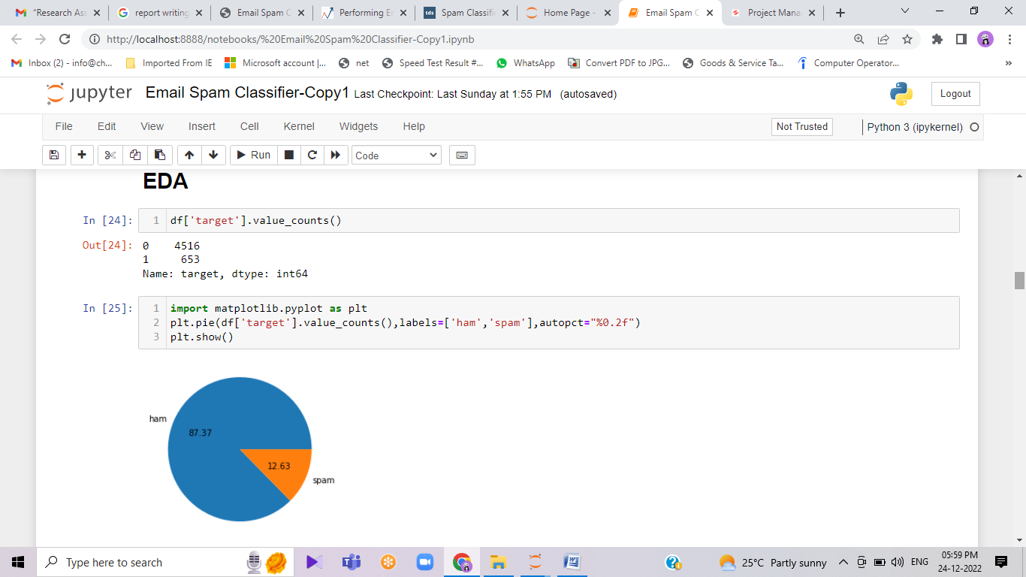
Spam Detection Exploratory Data Analysis
We will now do some of the Exploratory – Data Analysis to check how data is distributed along 2 categories. This will give us a feel if we need to do some type of preprocessing over data or is it on the same scale.
To perform this operation we will just be grouping the data based on category and call value_counts() method on it like:

Slide 12
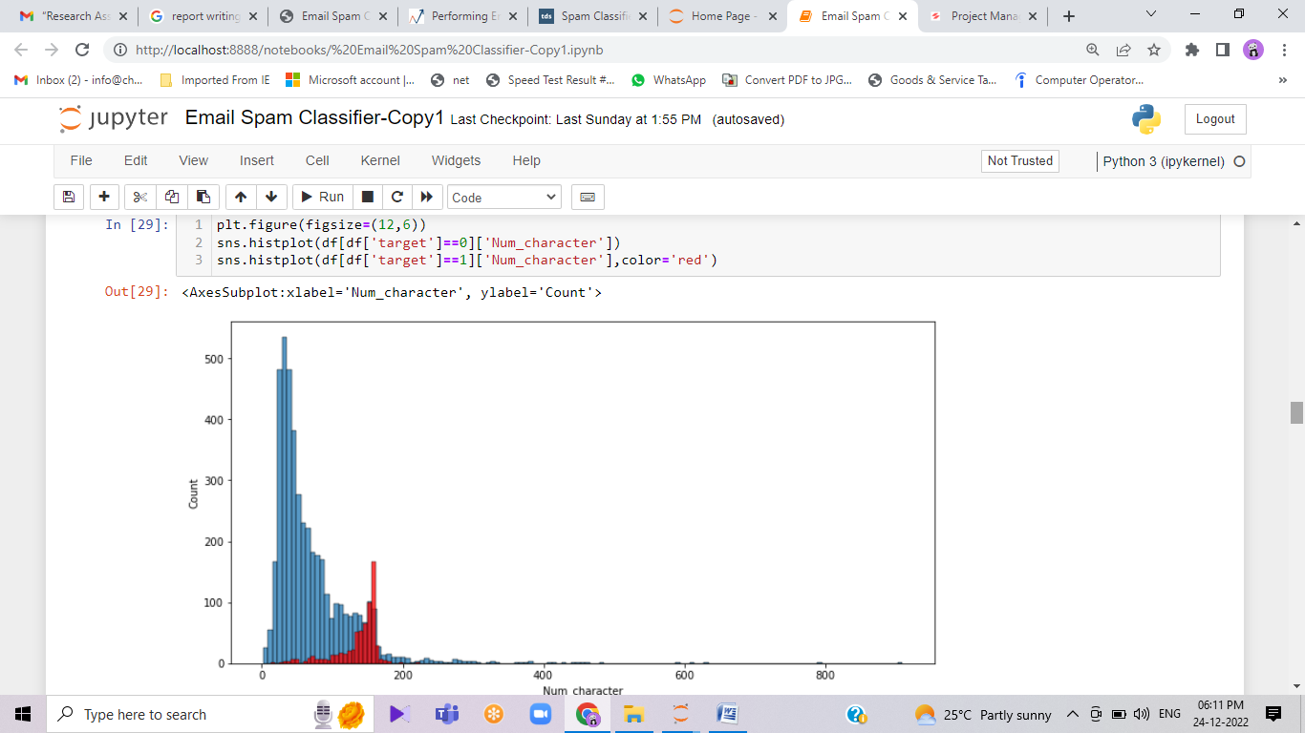
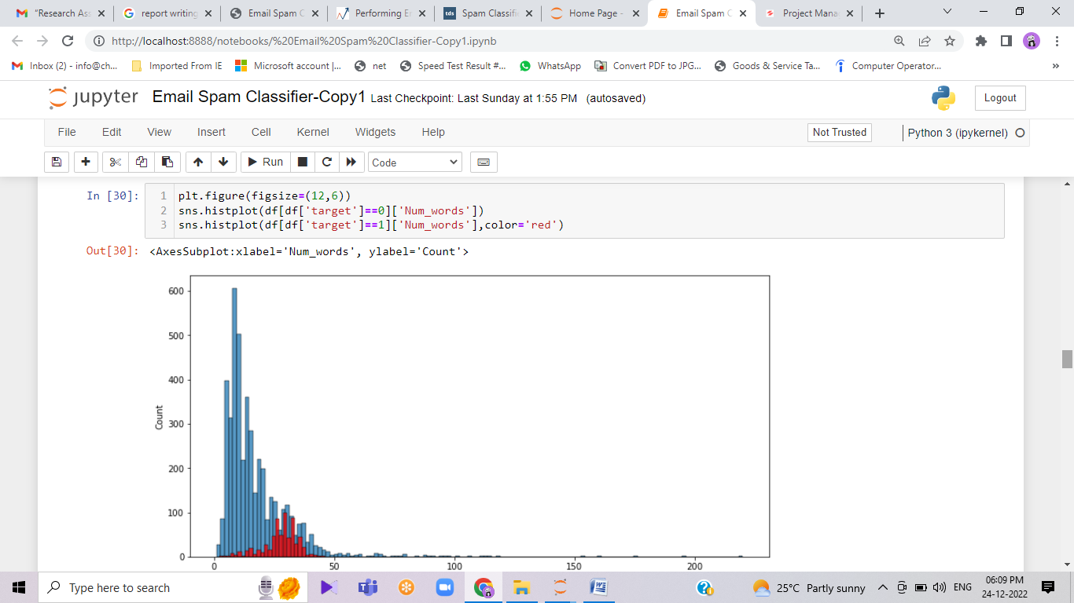
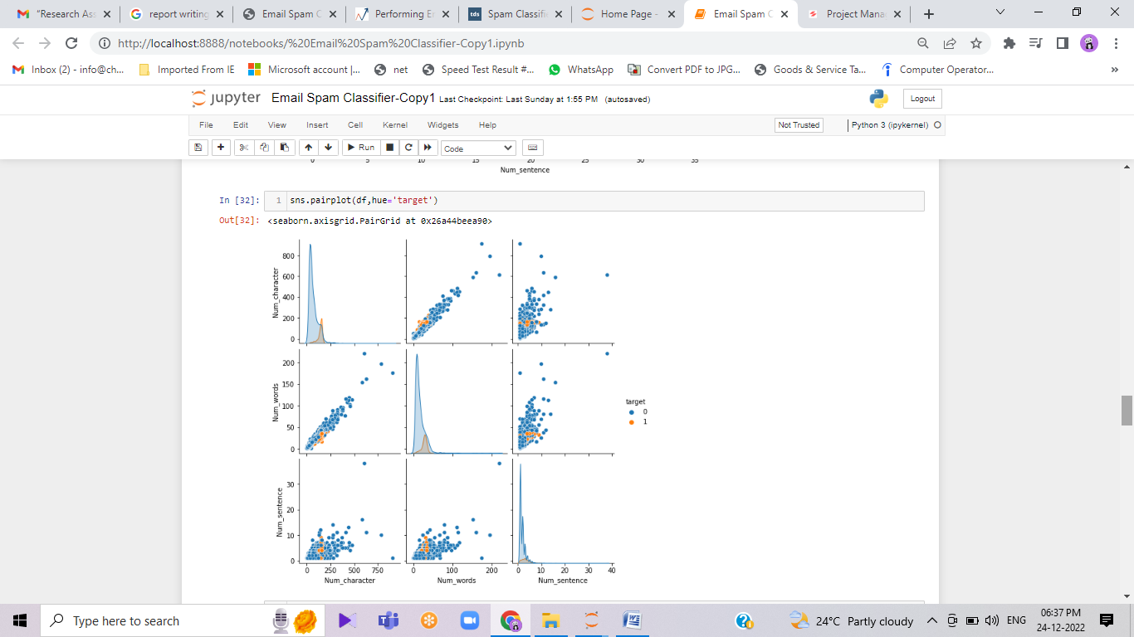
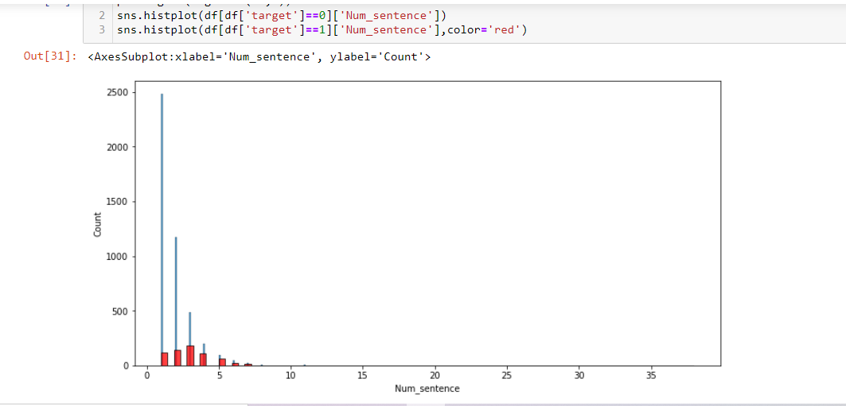

Slide 13
Preprocessing of Spam Detection Data
One Hot Encoding Categories
As can be seen, we have only text as categorical data, and the model doesn’t understand them. So instead of text, we can just assign integer labels to our class ham and spam as 0 and 1 respectively, and store it in new column spam. This is called- Hot-Encoding
To achieve this we will just be filtering the column category and perform operations:
1 – If a category is a ham/ not spam
0 – if the category is spam
The best part is that we can use the one-liner lambda function to achieve the following result and apply it to the dataframe for all values.
Lambda Fn Syntax = [lambda x : value expression else value]

Slide 14
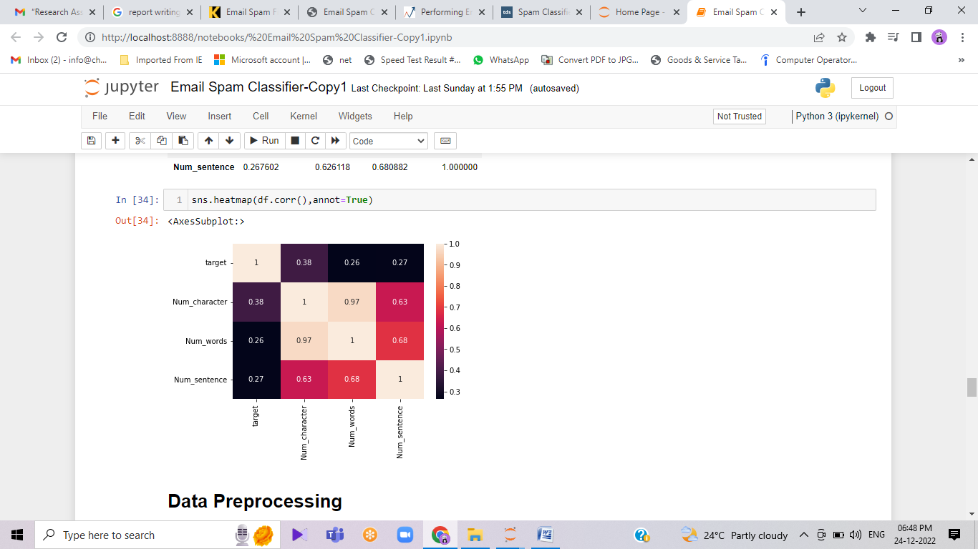
HEATMAP
As we see multicollinearity here, we cannot use all three columns instead we shall use only one and that should be num_characters has it has highest correlation with message_type.
Since we are working to classify Spam vs Non-Spam emails, it is crucial for us to avoid False-Positive classification, i.e., classifying a Non-Spam email as a Spam email. For this, we will check distribution of our classification.

Slide 15
Preprocessing:
Before starting with training we must preprocess the messages. First of all, we shall make all the character lowercase. This is because ‘free’ and ‘FREE’ mean the same and we do not want to treat them as two different words.
Then we tokenize each message in the dataset. Tokenization is the task of splitting up a message into pieces and throwing away the punctuation characters.
The words like ‘go’, ‘goes’, ‘going’ indicate the same activity. We can replace all these words by a single word ‘go’. This is called stemming. We are going to use Porter Stemmer, which is a famous stemming algorithm.

Slide 16
Preprocessing:
We then move on to remove the stop words. Stop words are those words which occur extremely frequently in any text. For example words like ‘the’, ‘a’, ‘an’, ‘is’, ‘to’ etc. These words do not give us any information about the content of the text. Thus it should not matter if we remove these words for the text.
Optional: You can also use n-grams to improve the accuracy. As of now, we only dealt with 1 word. But when two words are together the meaning totally changes. For example, ‘good’ and ‘not good’ are opposite in meaning. Suppose a text contains ‘not good’, it is better to consider ‘not good’ as one token rather than ‘not’ and ‘good’. Therefore, sometimes accuracy is improved when we split the text into tokens of two (or more) words than only word.

Slide 17
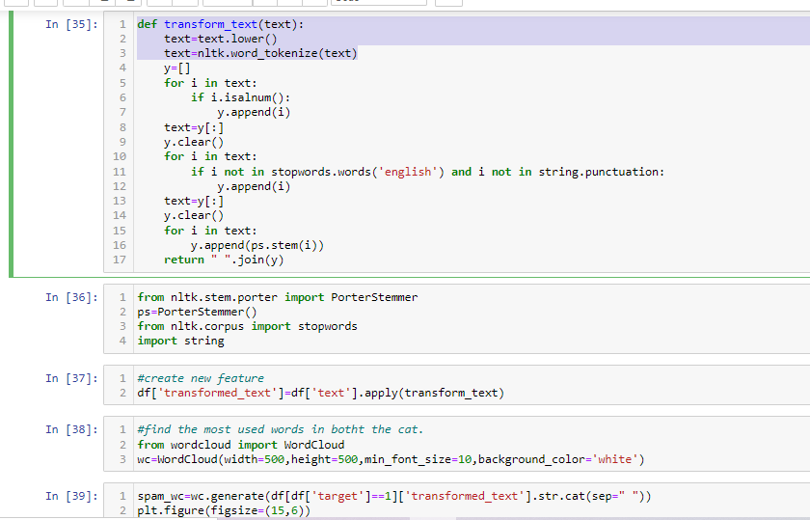

Slide 18
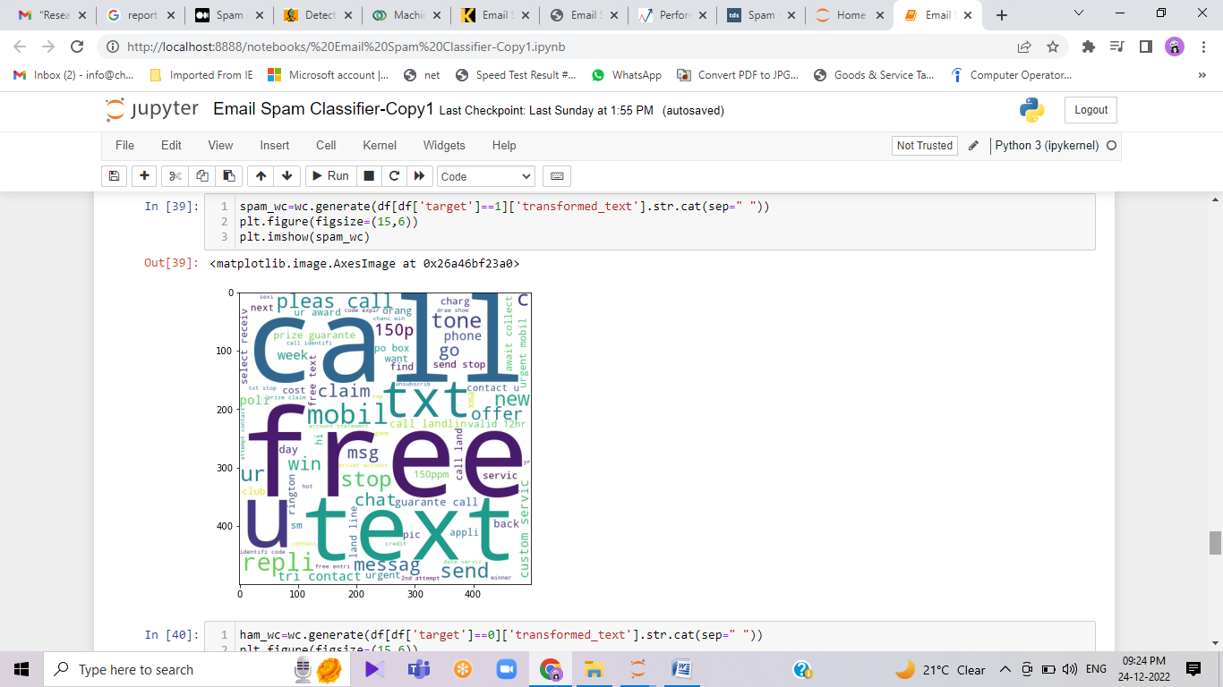
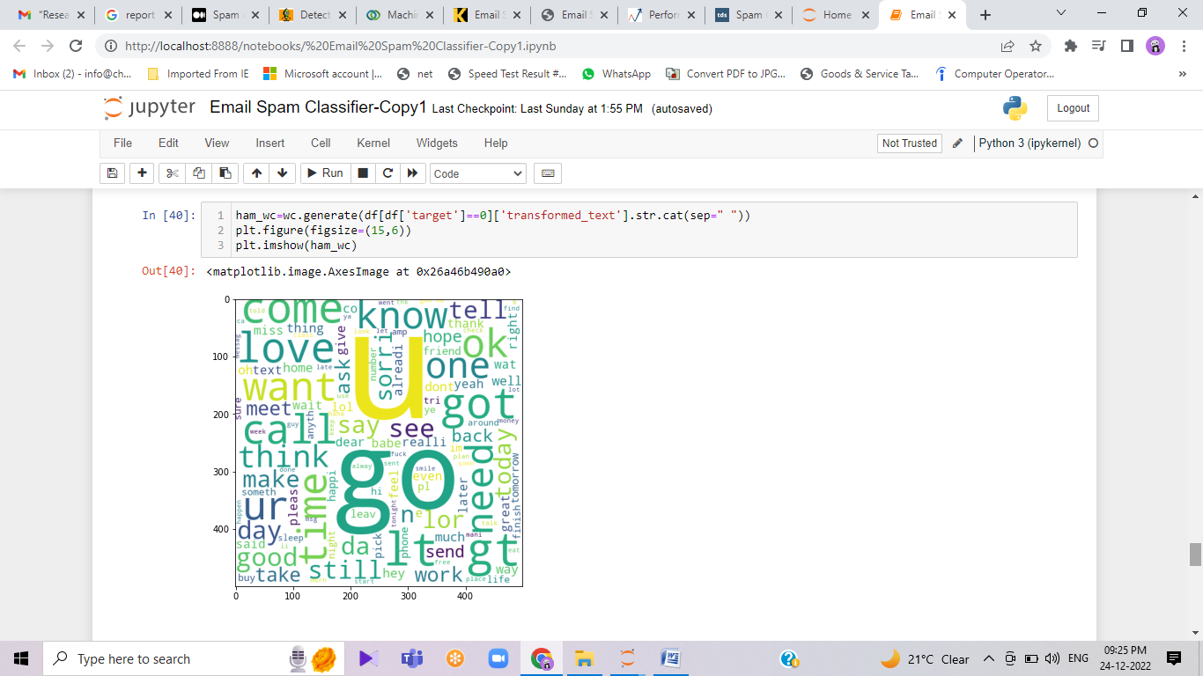
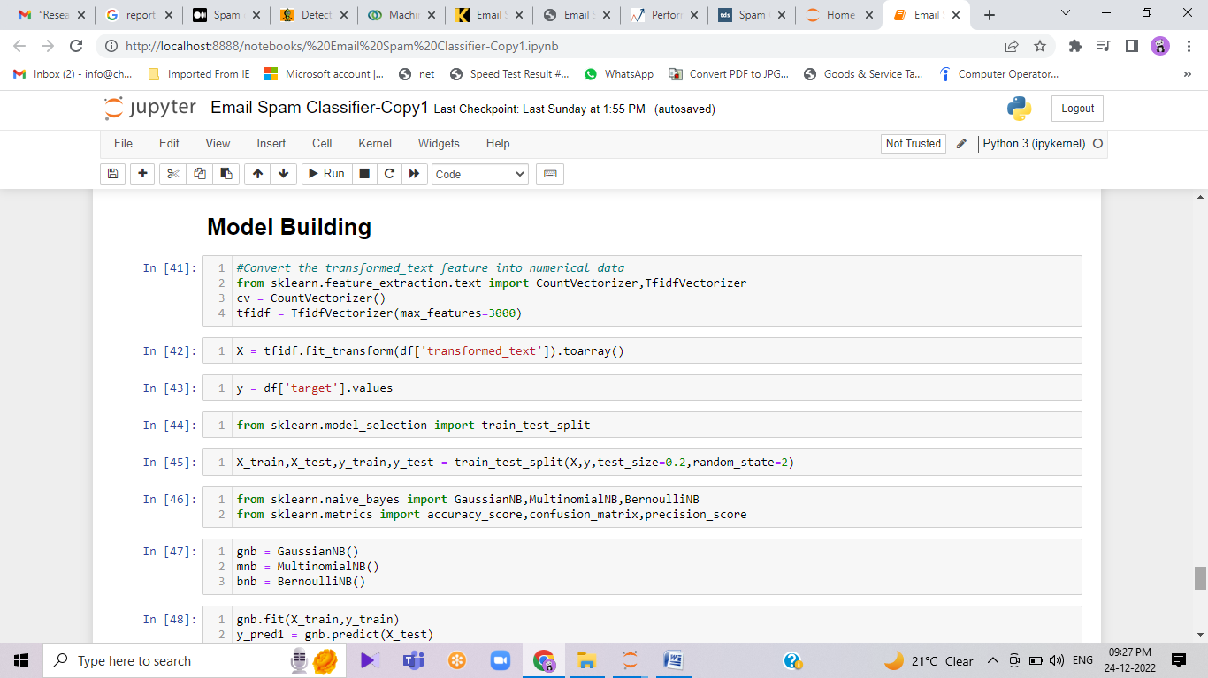

Slide 19
Building a Model using Naive Bayes
As it is known that on Textual Data Naive Bayes Algorithm works the best hence we will use it but along the way also compare it with different algorithms
Input is categorical Output is Numerical.
But as we know in the Naive Bayes algorithm the input columns should be numerical so we have to convert (VECTORIZE) the column.
How to vectorize:
Bag of Words
TFIDF
Word2vec
After trying out different techniques, I came to the conclusion that TFIDF vectorization gives the best accuracy and precision score so we will be using it.

Slide 20
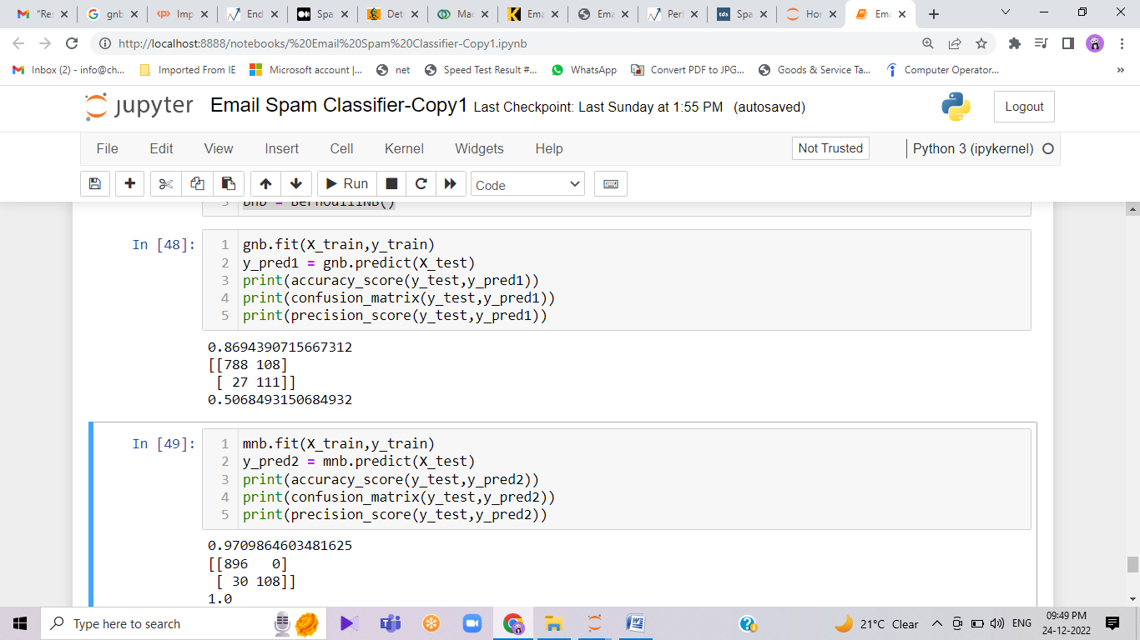
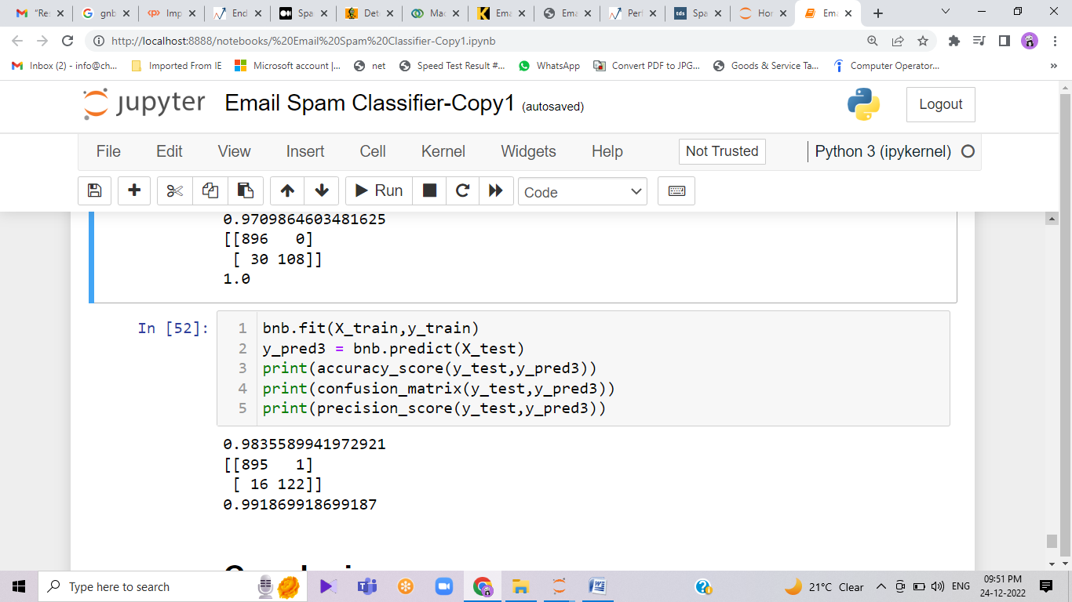

Slide 21
Continued…
Gaussian Naive Bayes is useful when working with continuous values which probabilities can be modeled using a Gaussian distribution
The multinomial naive Bayes performs better than the Gaussian variant and the result is not really surprising. In fact, each sample can be thought as a feature vector derived from a dictionary of 64 symbols. The value can be the count of each occurrence, so a multinomial distribution can better fit the data, while a Gaussian is slightly more limited by its mean and variance.
Hence we finalise the Model with MNB(Multinomial Naive Bayes) and TFIDF Vectorization.

Slide 22
Conclusion
The classifier accurately identified the email messages as spam or not spam with 99.2 % accuracy on the test data !
It is very unusual to having 100% success from a model. Obviously, it is due to small training and test dataset. I have tested my own emails using the model. It turned out that it is not as effective as my existing paid spam filter. It makes sense. There are many ways we can improve the model. If the model trains with sufficient data, it will deliver more accurate results.

Slide 23
Continued…
With the increase usage of emails, this study focuses on using automated ways to detect spam emails written. The study uses various machine learning and deep learning algorithms to detect them.
In the study, a translated emails dataset including spam and ham emails is generated from Kaggle, which is preprocessed for various approaches. Accuracy, precision, recall, F-measure, ROC-AUC, and model loss are used as comparative measures to examine performance.
The study concludes that deep learning models are more successful in classifying spam emails. Comparatively, LSTM algorithm has a high accuracy rate of around 98% with low model loss rate of 5%. Even though LSTM takes a little longer to train than CNN, SVM, or Naive Bayes, its efficiency and accuracy rate are far better than those of the other approaches.

Slide 24
Continued…
The creation of an actual dataset of emails can be considered as a viable future task. In addition, more recent artificial intelligent approaches may also be considered to detect spams.
A supportive tool using a browser plugin or API can be built for companies running their own email servers so that they can keep a check on emails and can identify and flag spam emails. Such a supportive tool can be used in conjunction with existing email service providers as well.

Slide 25
Data Ethics
There are many ethical and legal issues that can really take a toll on designing such models. Bank and Investment organizations that run their own email servers have confidential emails and identity information related to customers. Using such confidential information for the predictive analysis required to safeguard the client data with the care of a professional fiduciary. Need to protect the customer data from both intentional and inadvertent disclosure, also protecting it from misuse.
Also, while implementation it is possible to generate false positive, which means the emails which are not spam fall into the spam category. An important piece of information a company can miss if the user’s legit email is marked as spam. A client or user who is a loyal customer, his email can be marked spam, which is an ethical issue.

Slide 26
What is a spam filter?
A spam filter is a program used to detect unsolicited, unwanted and virus-infected emails and prevent those messages from getting to a user's inbox. Like other types of filtering programs, a spam filter looks for specific criteria on which to base its judgments.
Internet service providers (ISPs), free online email services and businesses use email spam filtering tools to minimize the risk of distributing spam. For example, one of the simplest and earliest versions of spam filtering, like the one that was used by Microsoft's Hotmail, was set to watch out for particular words in the subject lines of messages. An email was excluded from the user's inbox whenever the filter recognized one of the specified words.
This method is not especially effective and often omits perfectly legitimate messages, called false positives, while letting actual spam messages through.
More sophisticated programs, such as Bayesian filters and other heuristic filters, identify spam messages by recognizing suspicious word patterns or word frequency. They do this by learning the user's preferences based on the emails marked as spam. The spam software then creates rules and applies them to future emails that target the user's inbox.

Slide 27
THANK YOU

